Slide 1

Shell Bootcamp 2024 3 Reflections for Week 2 [2/9/24 -6/9/24]
Sumona Sud
Date : 6-September-2024

Slide 2

About Me
Drive with ambition, deliver with dedication, and uphold quality.

Slide 3

My learnings from this week!

Slide 4
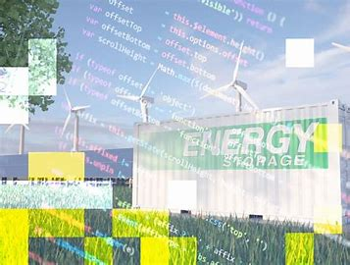
Learning 1 | My takeaways
DevOps Principles: Understanding continuous integration, continuous delivery, and continuous deployment.
DevOps promotes collaboration between development and operations for efficient and reliable software delivery.
Automating updates to energy monitoring systems using Azure Pipelines ensures they are always up-to-date.
`

Slide 5
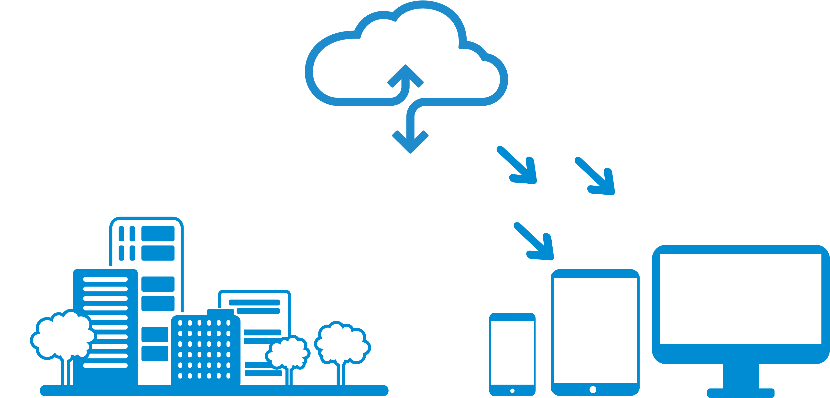
Learning 2 | My takeaways
DBMS Concepts: Understanding the basics of database management systems, including data models, schemas, and SQL.
A DBMS like PostgreSQL allows for efficient data storage, retrieval, and management, ensuring data integrity and security.
Using PostgreSQL to manage and analyze large datasets from energy consumption sensors can help optimize energy usage and reduce costs.
This Photo by Unknown Author is licensed under CC BY

Slide 6
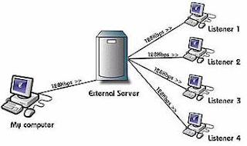
Learning 3 | My takeaways
Cloud Basics: Understanding the core concepts of cloud computing, including IaaS, PaaS, and SaaS.
Cloud computing provides scalable and flexible resources, allowing for efficient management and deployment of virtual machines (VMs).
Creating VMs in the cloud can support energy management applications, enabling scalable data processing and real-time analytics.

Slide 7

Relevance of learnings for my organization

Slide 8

Learning 1 | Relevance for Shell
DevOps Principles: Shell effectively implements continuous integration, continuous delivery, and continuous deployment to streamline their software development processes.
Collaboration: By promoting collaboration between development and operations teams, Shell ensures efficient and reliable software delivery.
Automation: Shell uses Azure Pipelines to automate updates to their energy monitoring systems, keeping them consistently up-to-date.
This Photo by Unknown Author is licensed under CC BY-SA-NC

Slide 9

Learning 2 | Relevance for Shell
DBMS Concepts: Shell effectively understands the basics of database management systems, including data models, schemas, and SQL.
Efficiency and Security: By using a DBMS like PostgreSQL, Shell ensures efficient data storage, retrieval, and management, maintaining data integrity and security.
Optimization: Shell leverages PostgreSQL to manage and analyze large datasets from energy consumption sensors
This Photo by Unknown Author is licensed under CC BY-SA

Slide 10

Learning 3 | Relevance for Shell
Cloud Basics: Shell effectively understands the core concepts of cloud computing, including IaaS, PaaS, and SaaS.
Scalability and Flexibility: Cloud computing provides Shell with scalable and flexible resources for efficient management and deployment of virtual machines (VMs).
Energy Management: By creating VMs in the cloud, Shell supports energy management applications, enabling scalable data processing and real-time analytics.
]
This Photo by Unknown Author is licensed under CC BY

Slide 11

Challenges in implementing learning

Slide 12
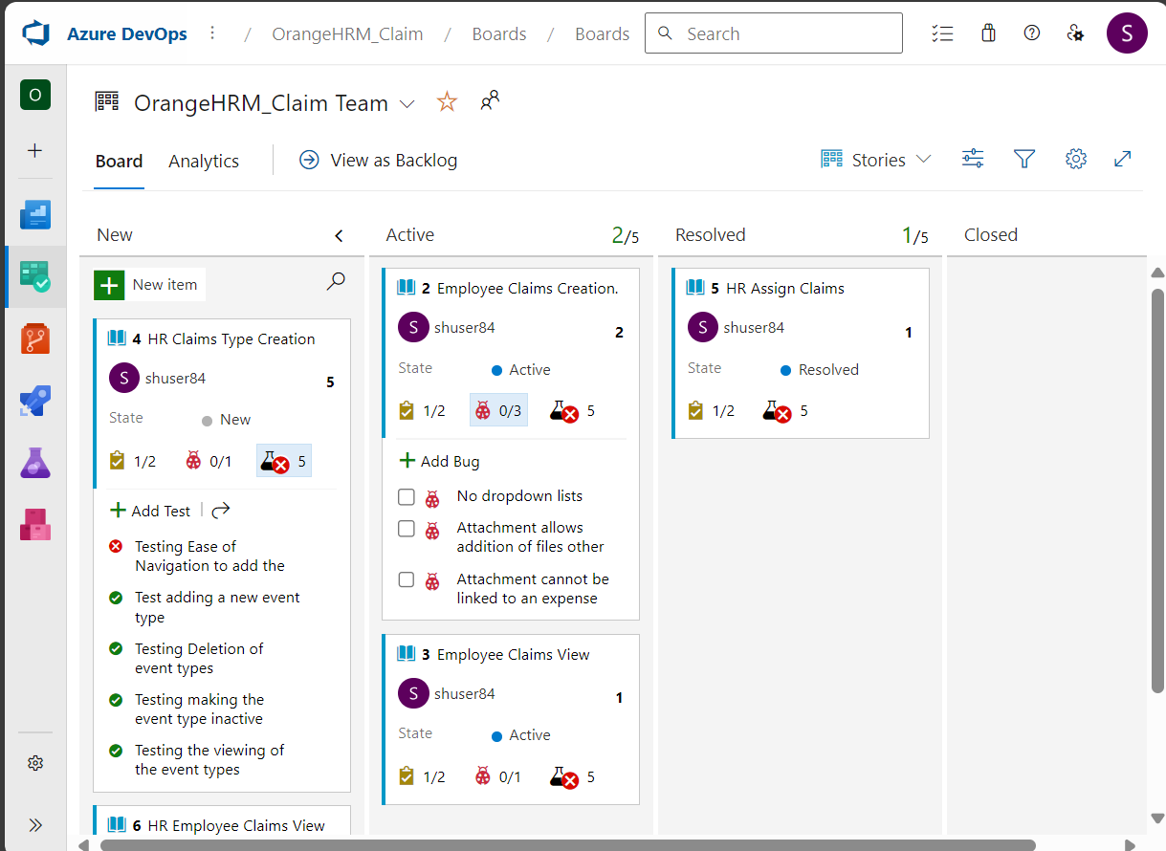
Challenge faced while implementing Learning 1
Implementing the devops on Azure with all the user stories was challenging
OrangeHRM_Claim Team Stories Board - Boards (azure.com)

Slide 13
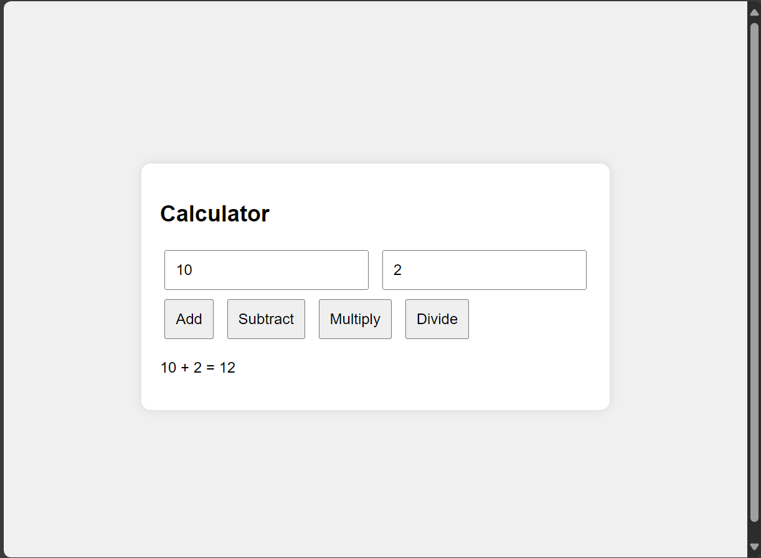
Challenge faced while implementing Learning 2
CI/CD on github actions was challenging
https://github.com/Sumo01/CalculatorCICD_CaseStudy.git

Slide 14
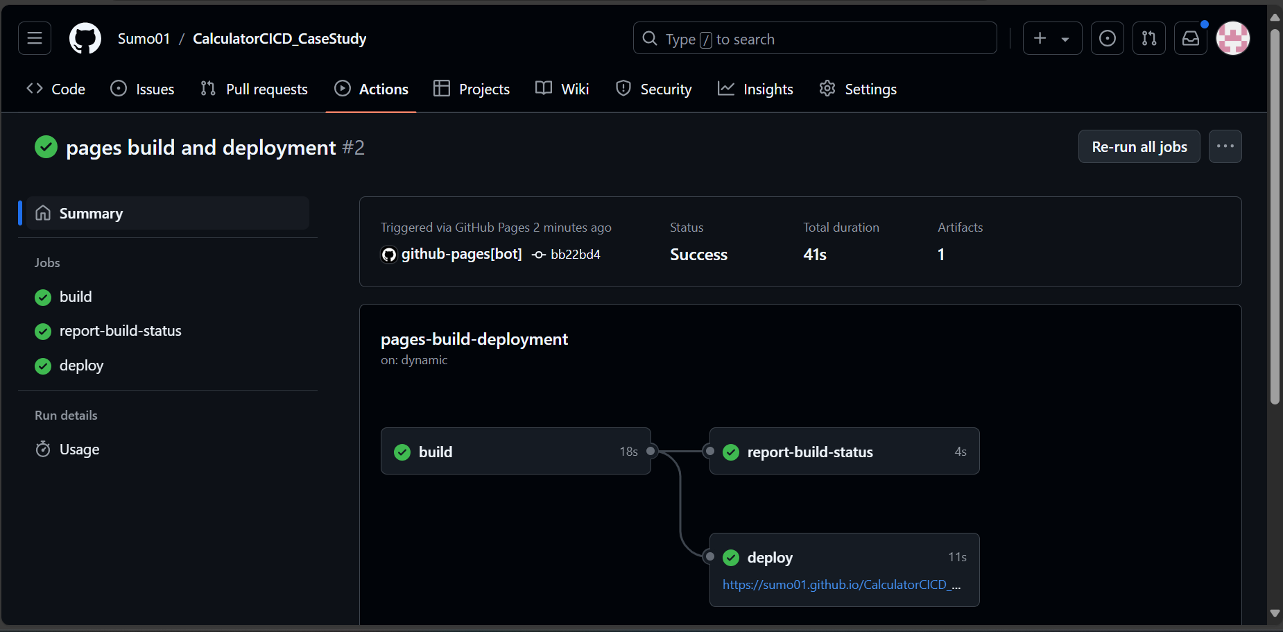
Challenge faced while implementing Learning 3
Learning postgres and joins was challenging

Slide 15

Action Plan

Slide 16
My Action Plan for this Week
Actions
Timeline
Status
Details of actions planned for the new lrearning or overcoming the challenge
The planned timeline to implement the actions
Status of the same by the end of the week

Slide 17

Learning is also Fun!

Slide 18
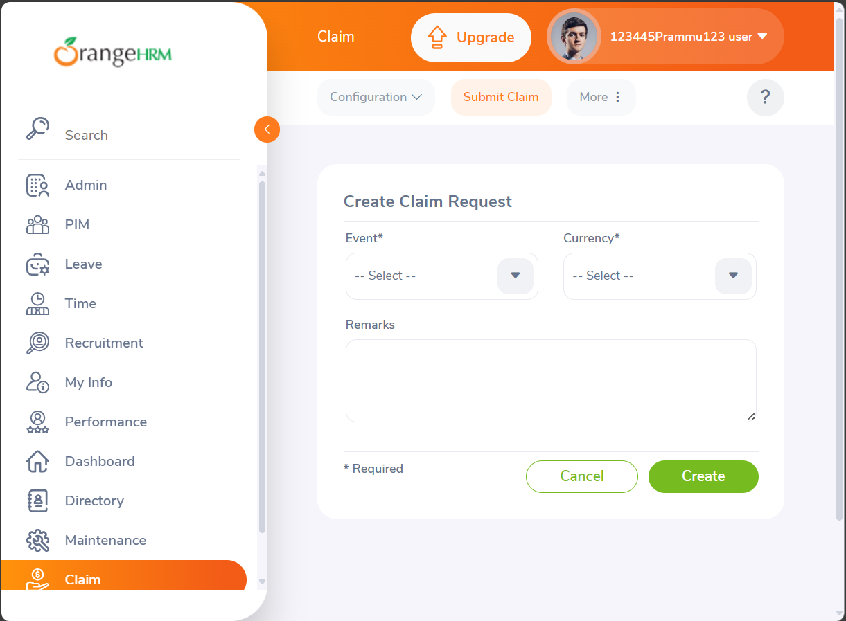
Learning is also Fun!
Case study was fun. Implementing what we learned was fun.

Slide 19

Summary
We learnt devops, files, cloud and the dbms concepts

Slide 20
Thank You

